Slide 1
North American Infection and Mortality Rates for COVID-19
Grant Jackson
Sylvia Nyakundi
Francis Duffy
Samantha Harding
Notes:
Sylvia

Slide 2

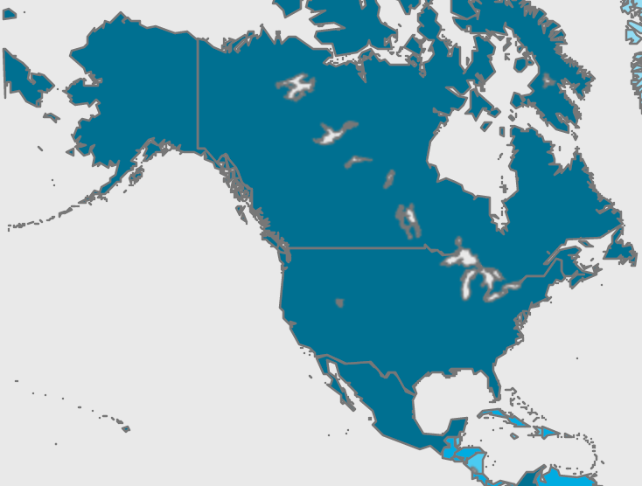
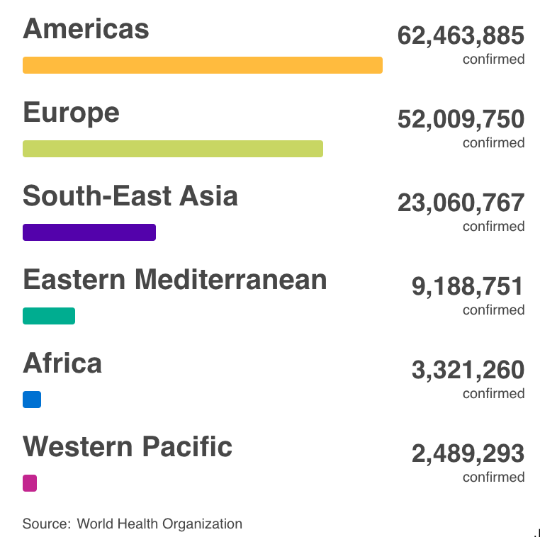
Motivations, Questions, and Data
Healthcare data in the US is notoriously difficult to find. There are currently a select few sources able to report accurate and timely statistics, at least in pa rt due to HIPPA regulations and the availability of claims data.
COVID-19 has seen a surge in the prevalence of data, with many APIs and downloadable sources offering statistics on the spread and mortality rates of the virus. While these APIs are sourced and visualized differently, most of them call on the same sources—they do not generate data, but rather increase awareness and utility.
Our group examined one such API, pulling its available statistics for countries in North America. We hoped to look at international trends in COVID-19 infection and morbidity rates by country and check for correlations between these measures and included demographic factors.
Source: Rapid API
Source: World Health Organization
Notes:
Sylvia

Slide 3
Questions
COVID-19 sources generally contain the same fundamental statistics surrounding infection and mortality counts and are often combined with raw population descriptors such as pop density and life expectancy. Our group wanted to see how well we could profile trends in infection and mortality throughout North America based on these offered statistics, specifically:
Which countries in North America have the highest infection rates? Mortality rates?
Do any of the provided demographic statistics have strong correlations with infection or mortality rate?
Can correlations be found between vaccination and case data?
What are the limitations of this dataset? Could existing external sources help to fix these limitations, or is further surveying required?
Notes:
Sylvia

Slide 4
Data Cleanup and Exploration
M-Media-Group offers free, international COVID-19 data. Because demographic, vaccine, and cases data were all provided and updated daily, we decided to investigate what kinds of visualizations and insights could be found from less traditional healthcare data sources.
One of the most interesting problems we encountered with this dataset was its structure—fields were grouped geographically rather than by summary value, so the json could not be directly loaded into a data frame without the loss of target statistics. Instead, we ran a loop that pulled only those geographies with values for all available columns and appended each result to an initially empty list.
Smaller, “nested” geographies did not contain all statistics, so filtering for regions with “all” both gave more fields to work with and narrowed down geography type to “country”
Our dataset contained a column that was depreciated, which would have skewed results had we included it in our analyses. The problem was easily solved by excluding said column from working data frames, but the process of working through why its statistics looked suspect was valuable.
Columns were created to show statistics per capita and population per square mile columns based on given population numbers
Notes:
Sam

Slide 5
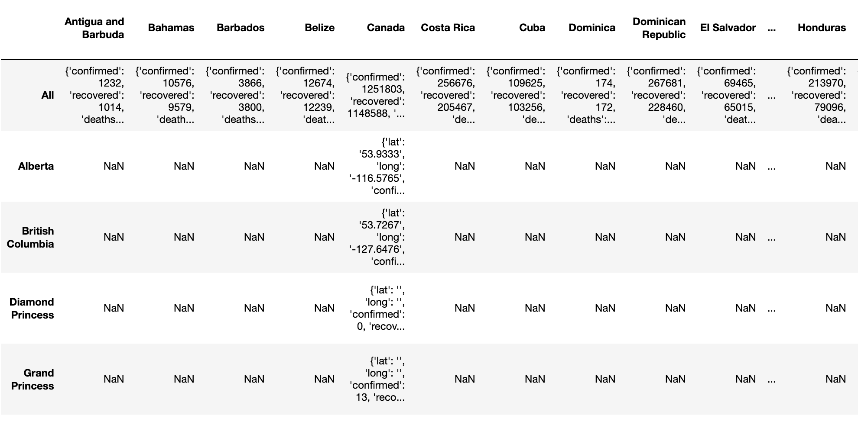
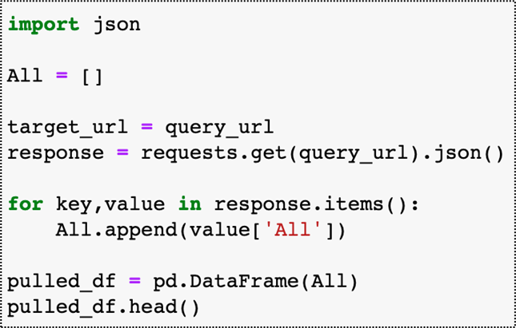
Data Cleanup and Exploration
One of the most interesting problems we encountered with this dataset was its structure—fields were grouped geographically rather than by summary value, so the json could not be directly loaded into a data frame without the loss of target statistics. Instead, we ran a loop that pulled only those geographies with values for all available columns and appended each result to an initially empty list.
Geographies
Geographies
Notes:
Sam

Slide 6
Data Analysis
Discuss the steps you took to analyze the data and answer each question you asked in your proposal
Question | Available Data | Visualization | Interpretation
Which countries in North America have the highest infection rates? Mortality rates? | Columns on infection and morbidity | Bar charts displaying infection and morbidity rates by country
Do any of the provided demographic statistics have strong correlations with infection or mortality rate? | Columns on infection and morbidity combined with population, population density, and life expectancy | Scatter plots with demographic variables as x-axis values and COVID-19 statistics as y-axis values, with trendlines included
Can any correlations be found between cases data and vaccination data? | Administered vaccines, complete vaccinations, partially complete vaccinations, columns on infection and morbidity | Scatter plots with vaccination data as x-axis values and infection and mortality data as y-axis values, with trendlines included
Notes:
Sam

Slide 7
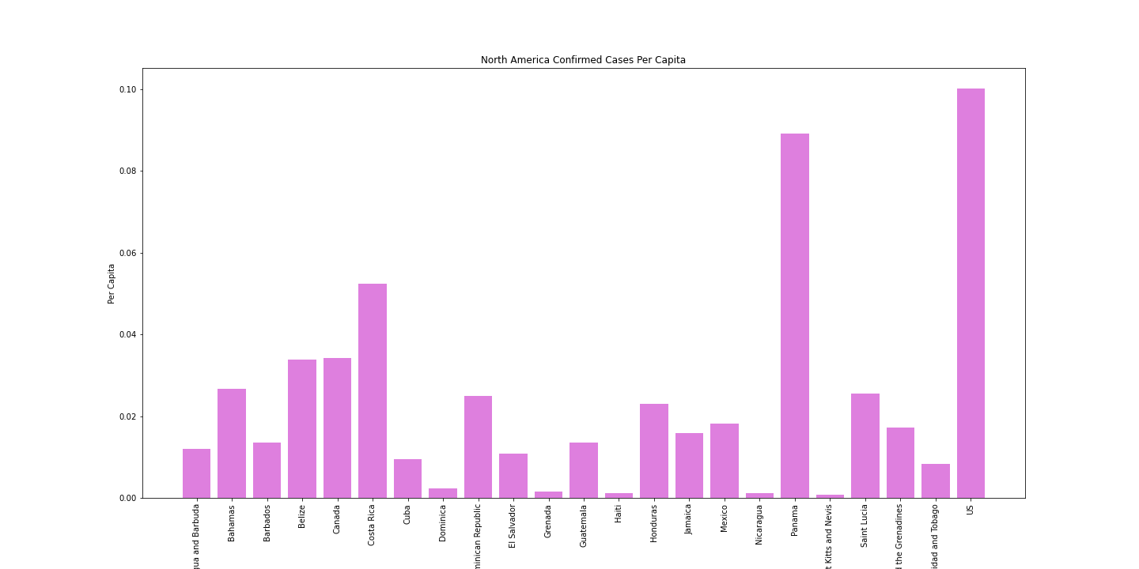
Data Analysis Question 1
The United States has the highest number of confirmed cases in North America
The US has high access to testing, and a high overall population, which likely skews these results when compared to other countries
Testing for COVID-19 in Mexico is reported 28,000 tests per 1,000,000 residents, much lower than other North American countries. Since this data is not accounted for, results are skewed.
North American Confirmed Cases per Capita
Notes:
Grant

Slide 8
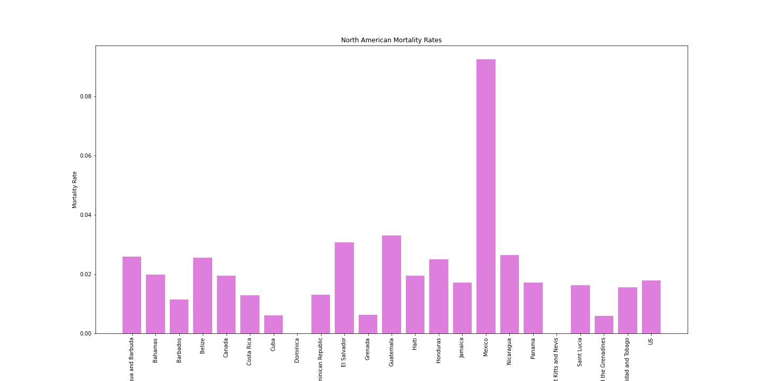
Data Analysis
Question 1
When compared to the number of confirmed cases by country, Mexico has a higher number of COVID-19 related deaths than expected
Similarly, the US has a low number of COVID-19 related deaths compared to its number of confirmed cases
North American Mortality Rates
Notes:
Grant

Slide 9
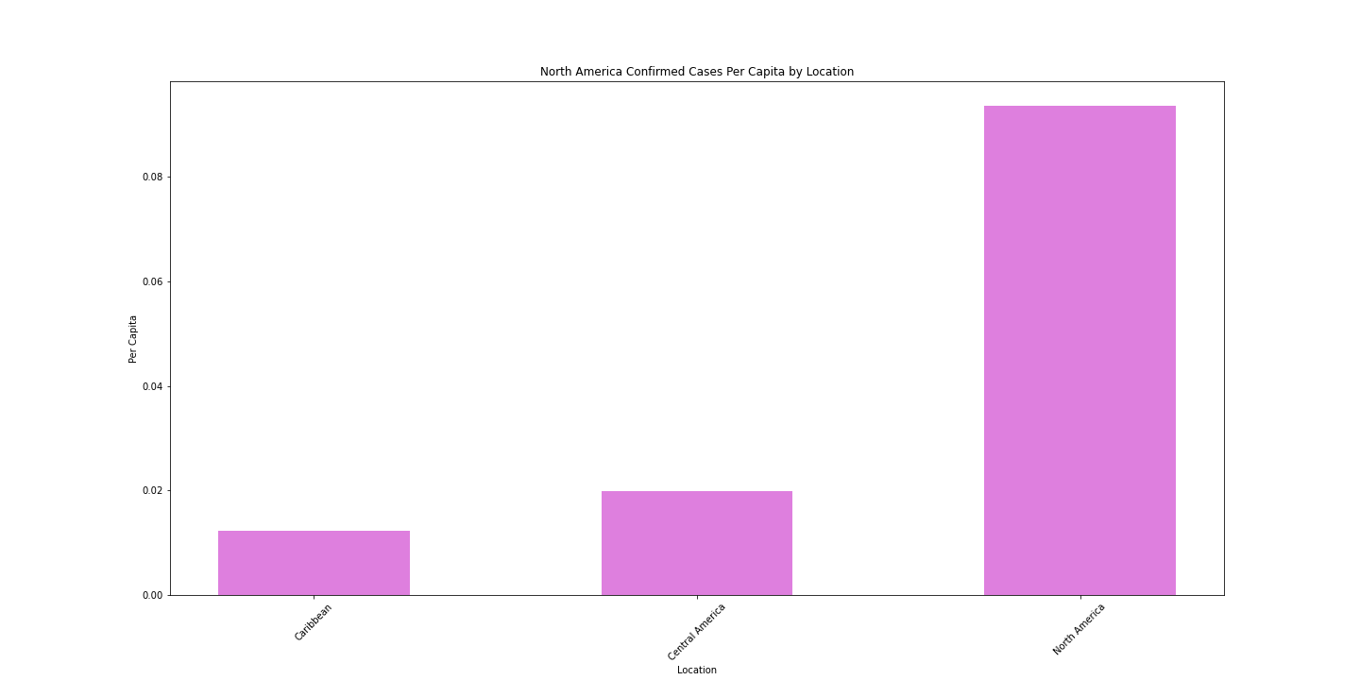
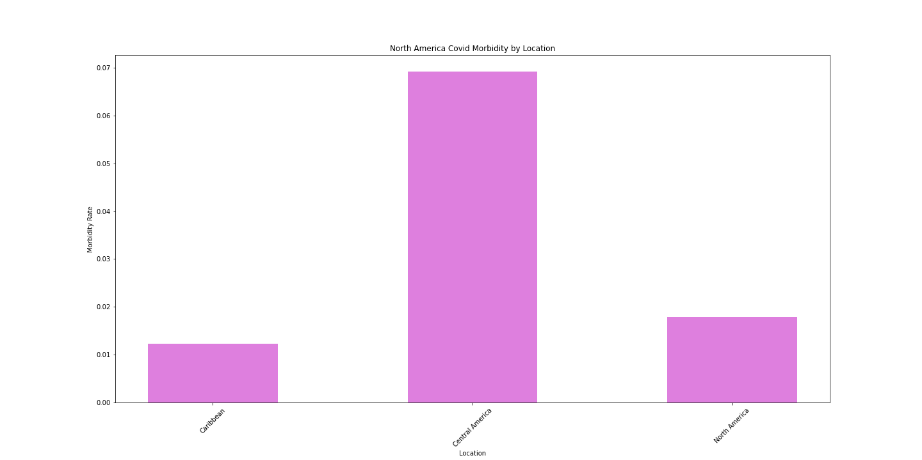
Data Analysis Question 1
North America has the highest per-capita rate of confirmed cases, but Central America has the highest morbidity rate. These results could suggest higher testing in North America.
North American Confirmed Cases by Location
North American Covid Mortality by Location
*
*
Notes:
Grant

Slide 10
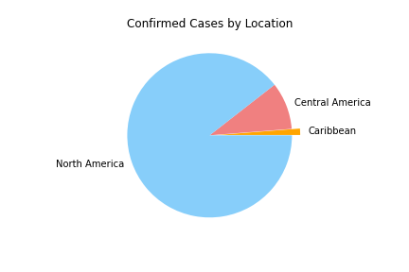
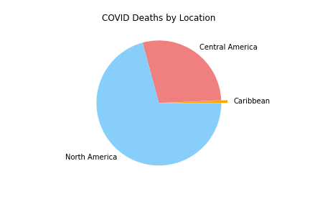
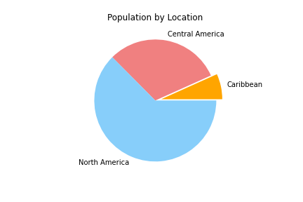
Data Analysis Question 1
North America again has the highest proportion of confirmed cases by location. This proportion goes down when you look at deaths, and down again when you view the region’s overall population.
The Caribbean’s proportion of COVID infection and deaths is much lower than its population would expect, which could be attributed to travel restrictions, masks, and geography
*
*
*
*North America, as a location, is defined in the data to be the US, Mexico, and Canada
Notes:
Grant

Slide 11
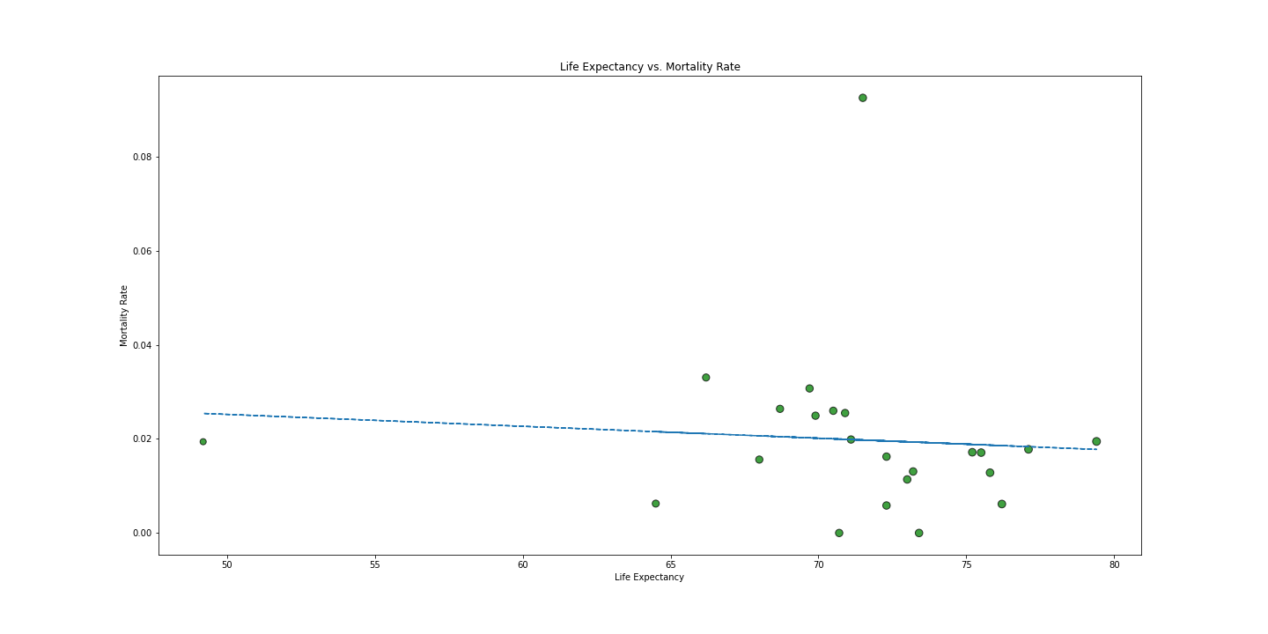
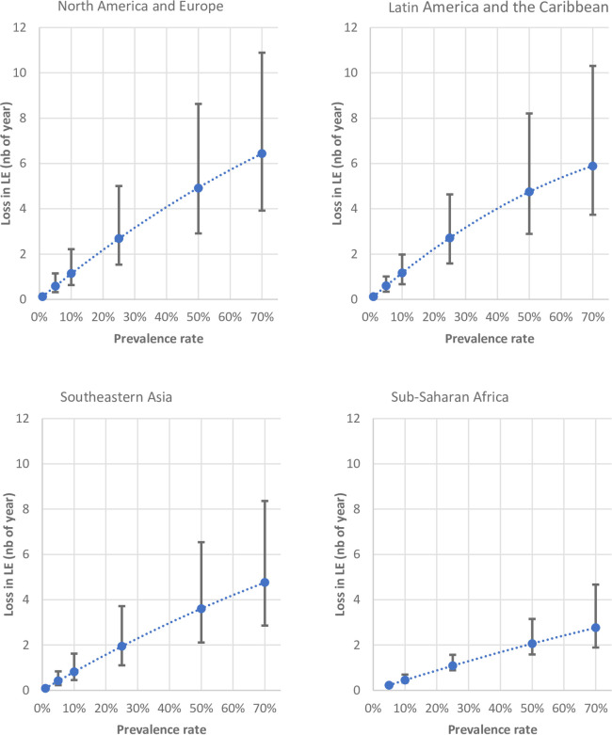
Data Analysis Question 2
There is a slight negative correlation between life expectancy and the mortality rate of COVID-19.
Since the r-squared is: 0.0073834351132869205, this correlation is not strong.
Post-COVID-19 effects on life expectancy, particularly mortality rates among vulnerable population subgroups, will be an interesting and impactful research problem for years to come.
Life Expectancy vs. Mortality Rate
Notes:
Grant

Slide 12
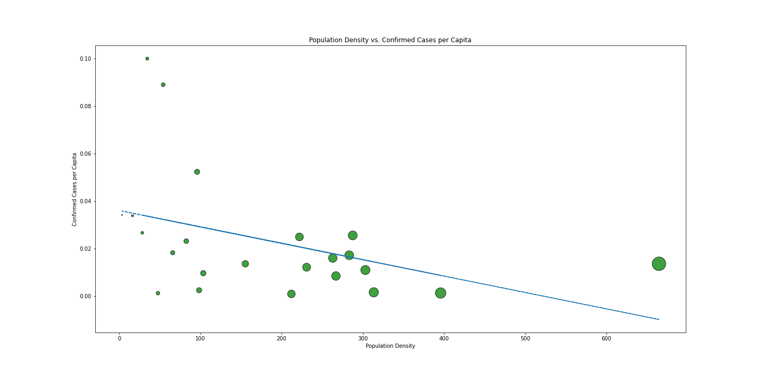
Data Analysis Question 2
We would have assumed that densely populated areas would have higher rates of COVID-19 infection, which is contrary to the results below.
Availability of testing and vaccination rollout were among uncontrolled factors that could have led to a counterintuitive result.
The r-squared is: 0.17422873249674384
Population vs. Confirmed Cases per Capita
Notes:
Frank

Slide 13
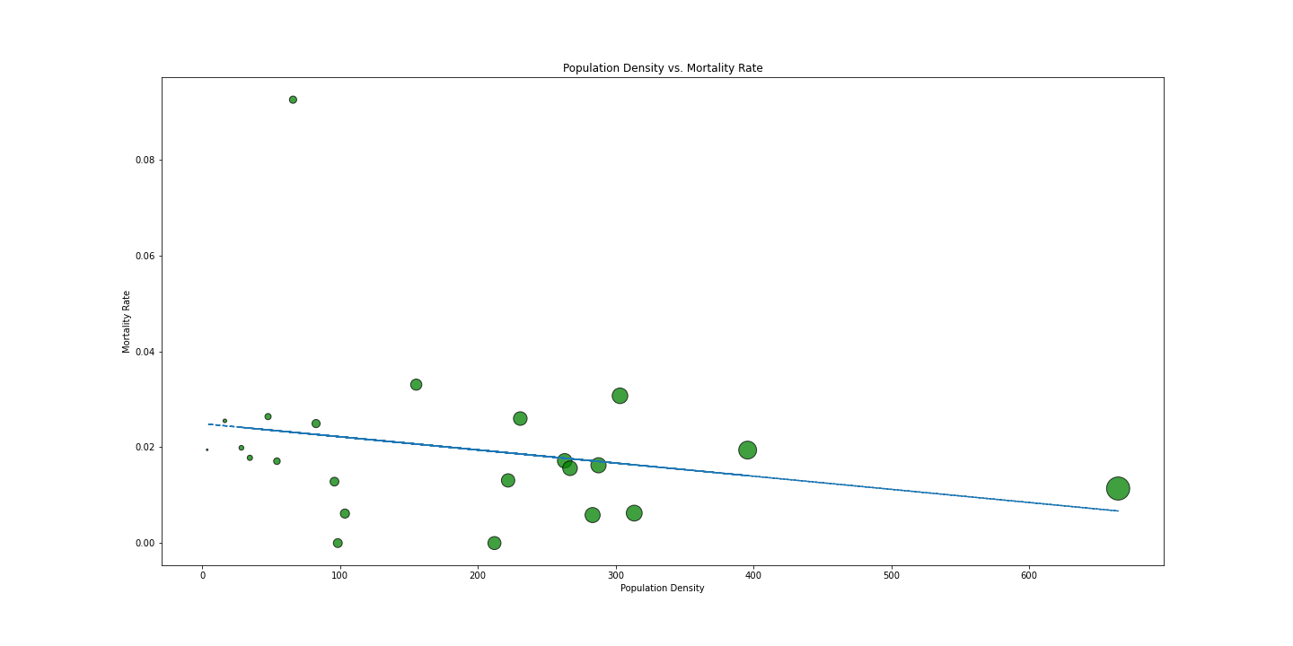
Data Analysis Question 2
Like the scatter plot before, this graph gives a result that is opposite from what we might have expected. The same uncontrolled variables apply
The r-squared is: 0.053629448694318176
Population Density vs. Mortality Rate
Notes:
Frank

Slide 14
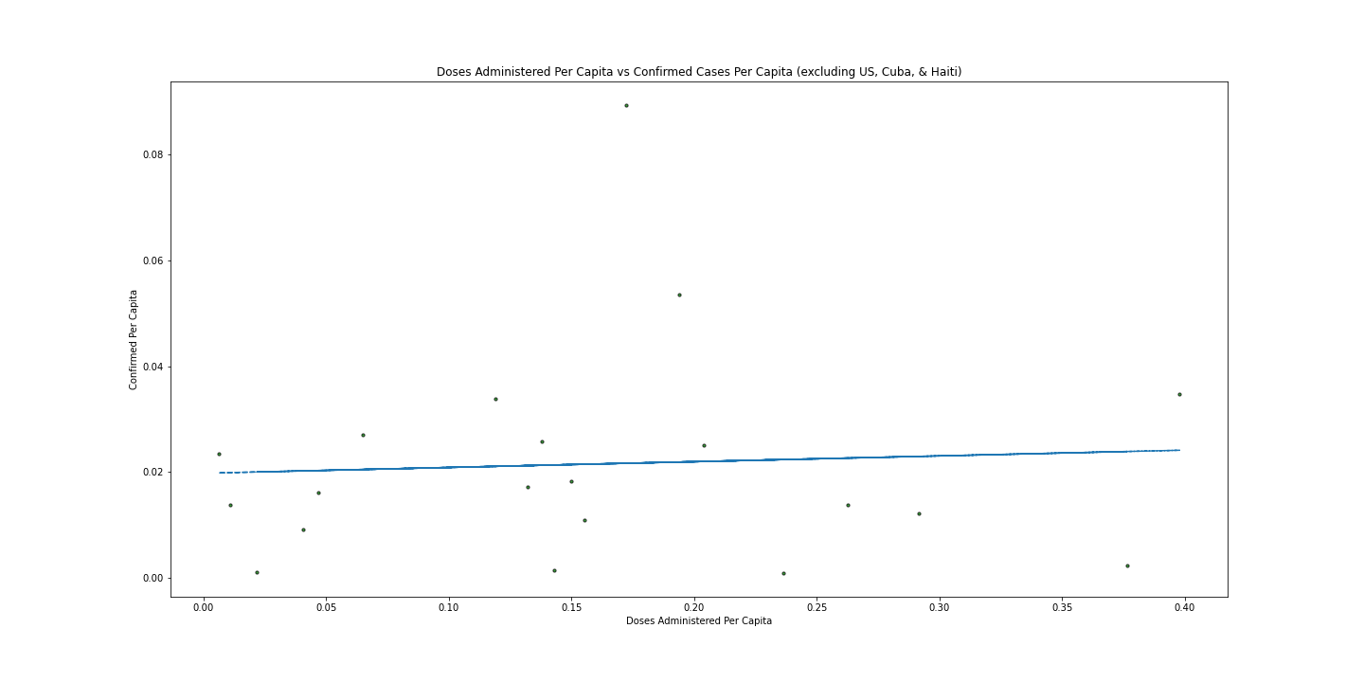
Data Analysis Question 3
We would expect vaccination to have a negative correlation with diagnosed COVID cases per capita, but this result is not shown in our data.
Vaccine lag could account for some of this discrepancy, especially for countries whose rollout has just started. Since the M-Media-Group API did not have historical vaccination data, we were unable to test this result.
Administered Doses Per Capita vs. Confirmed per Capita
Notes:
Sam

Slide 15
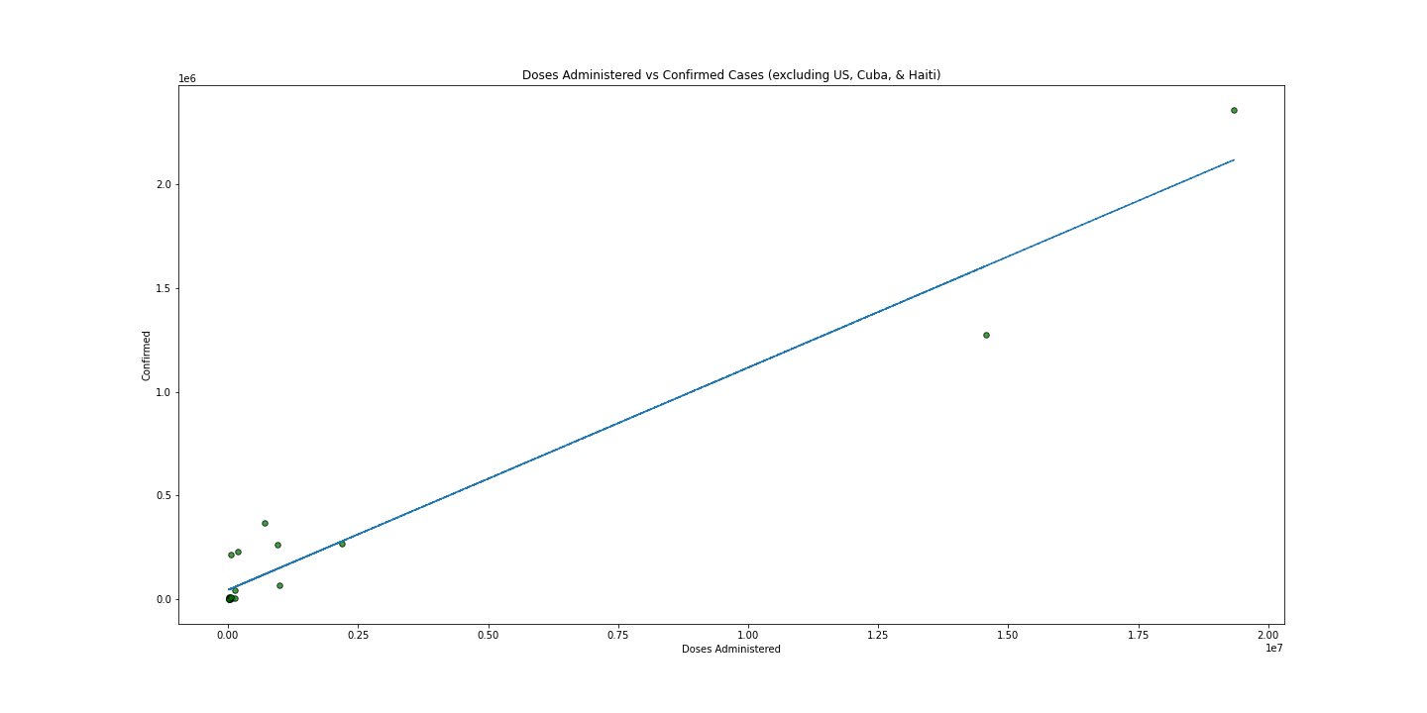
Data Analysis Question 3
When looking directly at administered vaccinations and confirmed cases, the correlation is strong and positive. This result is likely skewed by each country’s underlying population.
Administered Doses vs. Confirmed Cases
Notes:
Sam

Slide 16
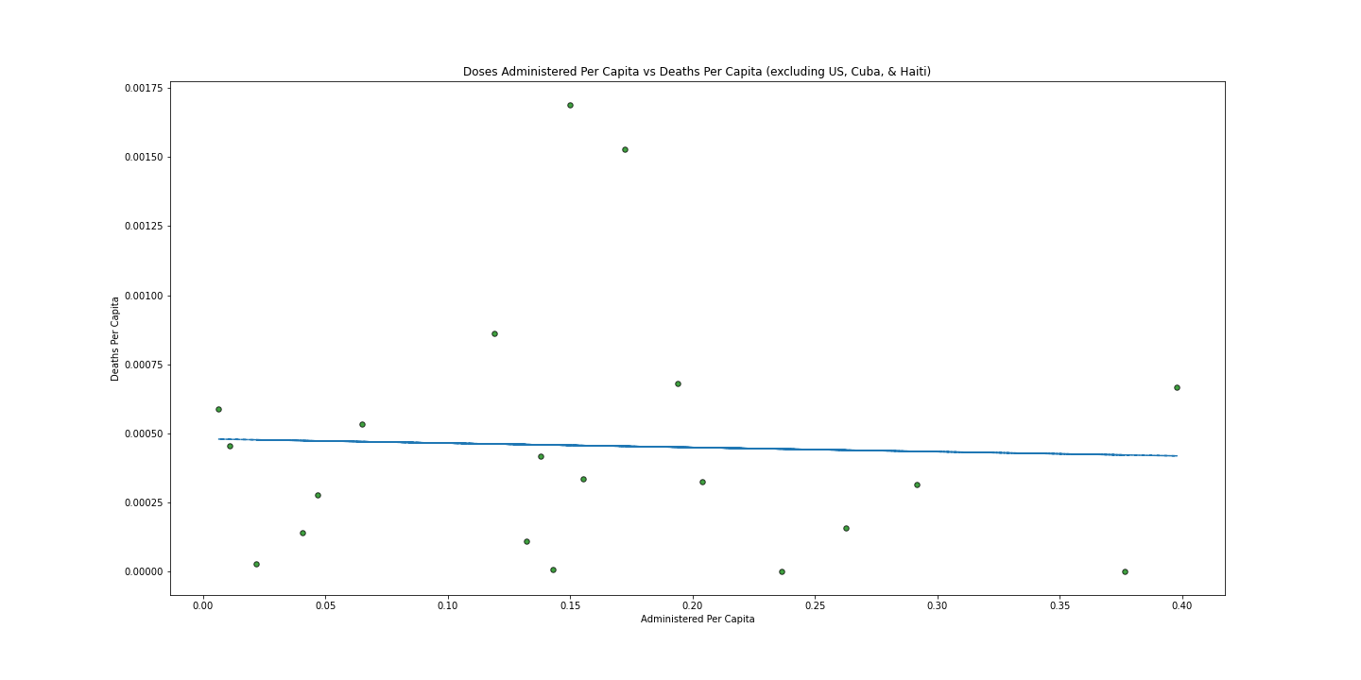
Data Analysis Question 3
We would expect vaccination to have a negative correlation with COVID deaths per capita, but this result is not shown in our data.
Vaccine lag could account for some of this discrepancy, especially for countries whose rollout has just started. Since the M-Media-Group API did not have historical vaccination data, we were unable to test this result.
It would be interesting to see how vaccination rollout impacted different age groups.
Administered Doses per Capita vs. Deaths per Capita
Notes:
Sam

Slide 17
Data Analysis
Discuss the steps you took to analyze the data and answer each question you asked in your proposal
Question | Available Data | Visualization | Interpretation
Which countries in North America have the highest infection rates? Mortality rates? | Columns on infection and morbidity | Bar charts displaying infection and morbidity rates by country | The United States has the highest measured infection rate, but Mexico has the highest measured mortality rate.
Do any of the provided demographic statistics have strong correlations with infection or mortality rate? | Columns on infection and morbidity combined with population, population density, and life expectancy | Scatter plots with demographic variables as x-axis values and COVID-19 statistics as y-axis values, with trendlines included | There were likely not enough datapoints to get a strong correlation, and even if there were the testing data itself is likely not consistent enough to produce valid results
Can any correlations be found between cases data and vaccination data? | Administered vaccines, complete vaccinations, partially complete vaccinations, columns on infection and morbidity | Scatter plots with vaccination data as x-axis values and infection and mortality data as y-axis values, with trendlines included | Correlations are, again, not strong enough to draw conclusions, and with the added complications of vaccine lag and a lack of historical data any correlations would be unreliable.
Notes:
Each their own question

Slide 18
Discussion
Limitations found in this dataset included:
Variability in testing data from different countries
Testing in Mexico, for example, is lower than in other North American countries. Since deaths are easier to tally than untested infections, this likely skewed Mexico’s morbidity rate significantly.
Lack of historical data for vaccine rollout
Lack of reliable recovery data due to depreciated column and difficulty of measure
Notes:
Grant

Slide 19
Post-Mortem
With two more weeks, two possible project extensions would be interesting to explore:
Compare to 1918 pandemic
The M-Media-Group API had several other categories of data available, namely historical data
History data would solve the problem of not being able to track infection and deaths over time, bringing this API’s utility closer to more established sources
Comparing more established international healthcare data sources across the same geographies as were examined with the M-Media-Group API would give an interesting view of each source’s differences, as we could contrast their breadth and utility
Investigating discrepancies in access to testing would be an interesting next step, especially as it would point out flaws in current statistics and comparisons.
Notes:
Sam

Slide 20
Questions
Please ask questions if you have them.

Slide 21
Sources
API provided open-source by M-Media-Group, available at https://github.com/M-Media-Group/Covid-19-API
COVID-19 stock image is public domain, provided by the CDC and available at https://www.cdc.gov/media/subtopic/images.htm
Information on the WHO Coronavirus (COVID-19) Dashboard was pulled from https://covid19.who.int/
PubMed article on the impact of COVID-19 on life expectancy https://pubmed.ncbi.nlm.nih.gov/32941467/

